Slide 1
Chapter 7. Sinusoidal Steady-State Circuit Analysis

Slide 2
Chapter 7 (1)
Sinusoidal Source
Sinusoidal Response
The Phasor
VCR of Passive Elements in Phasor

Slide 3
Chapter 7 (2)
KCL and KVL in Phasor
Mesh-Current Method
Node-Voltage Method
Thévenin and Norton Equivalents
Sinusoidal Steady-State Power Calculations

Slide 4
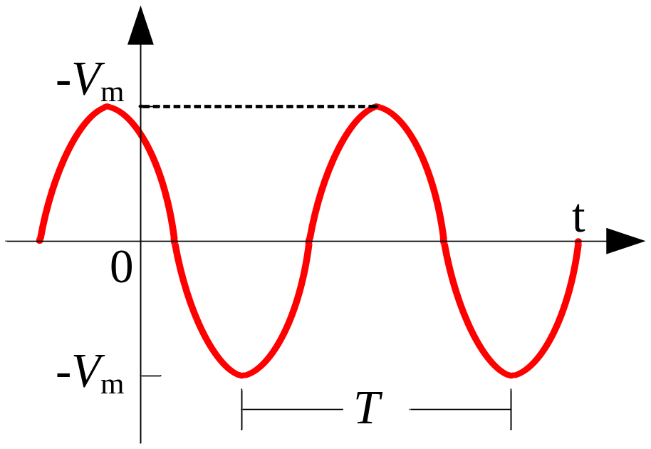
7-1 Sinusoidal Source
Sinusoidal Voltage/Current Source: Voltage/Current varies sinusoidally with time.
Alternative Current (AC)

Slide 5
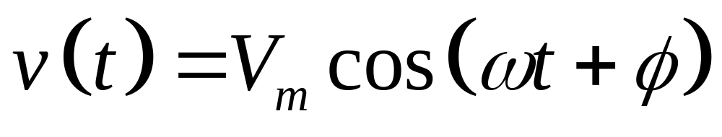


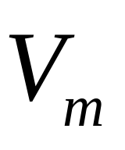
Parameters of Sinusoidal Function
: Initial phase angle determines the value at t = 0.
: Angular frequency determines the rate varying with time.
: Amplitude determines the maximum value.

Slide 6
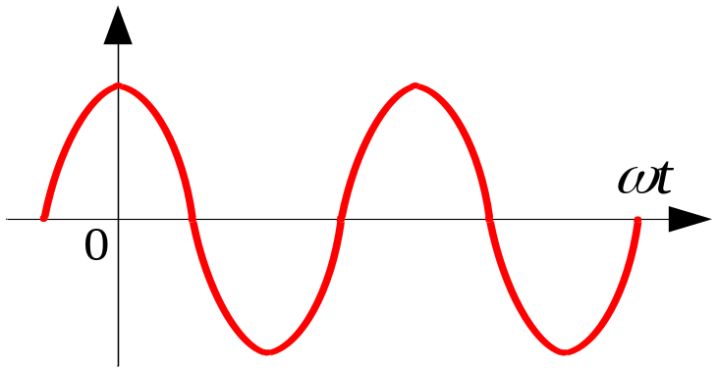
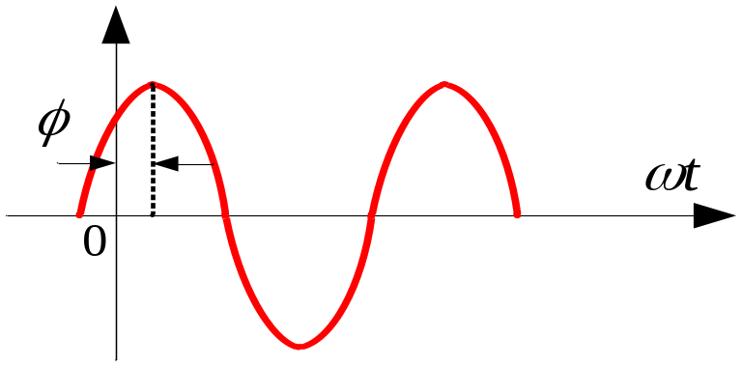
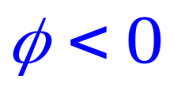
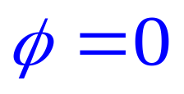
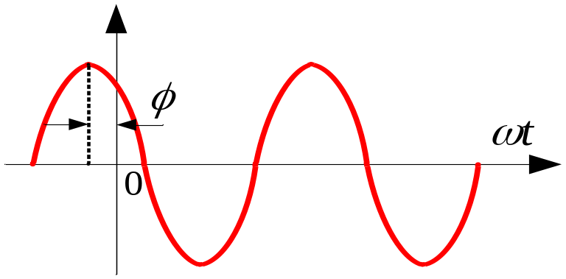
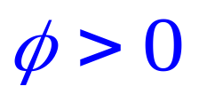
Phase Angle
: Initial phase angle determines the value at t=0.

Slide 7
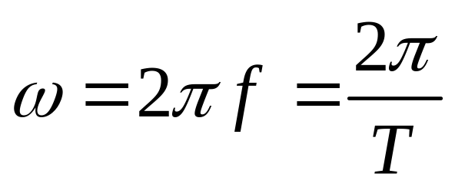
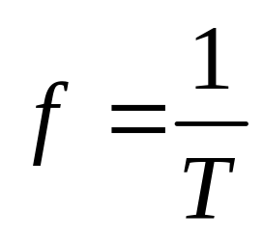

Angular Frequency
: measured in radians/second
: measured in hertz (Hz)
: measured in seconds

Slide 8
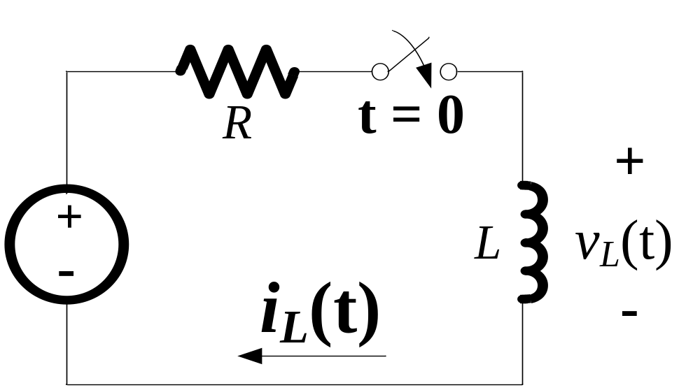
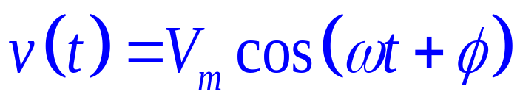

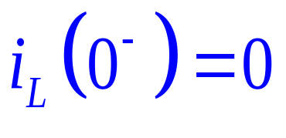
7-2 Sinusoidal Response
The initial current of the inductor is zero.
The switch is closed at t = 0;
Find the inductive current.

Slide 9
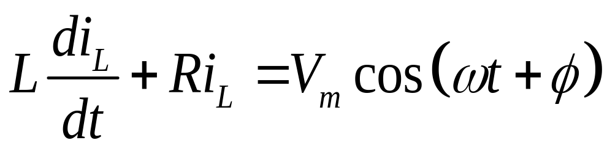
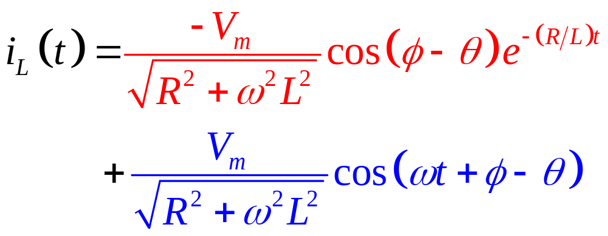
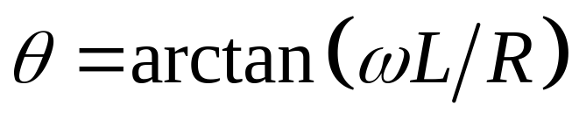
Solution:
By KVL for the loop:
in which,

Slide 10
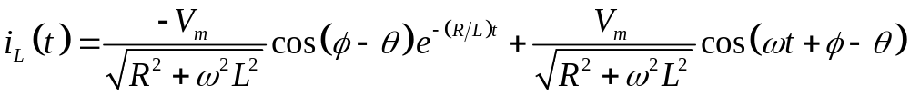
Sinusoidal Response
Transient Response
Steady State Response
The transient response becomes infinitesimal as time elapses;
The steady state response exists as long as the source continues to supply the voltage.

Slide 11
The transient response becomes infinitesimal as time elapses;
The steady state response exists as long as the source continues to supply the voltage;
Because the transient response vanishes as time elapses, the steady state response must also satisfy the differential equation.

Slide 12
Steady State Response
In a linear circuit driven by sinusoidal sources, the steady state response is also a sinusoidal function;
The frequency of the steady state response is identical to the frequency of the sinusoidal source;
The amplitude and phase angle differ from those of the sinusoidal source.

Slide 13
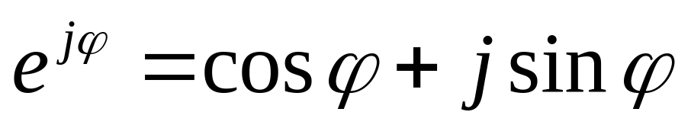
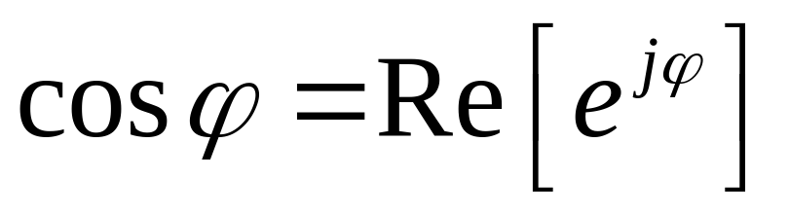
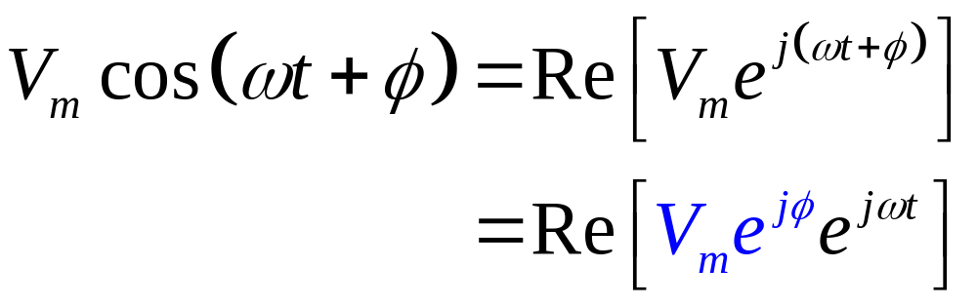
7-3 Phasors
Euler’s formula:

Slide 14
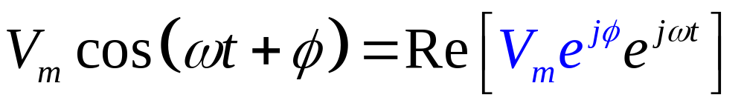
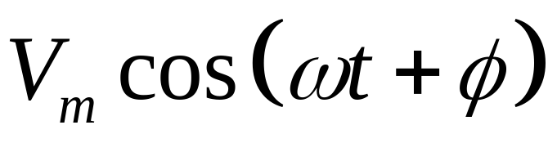
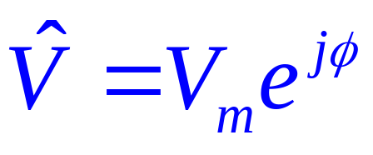
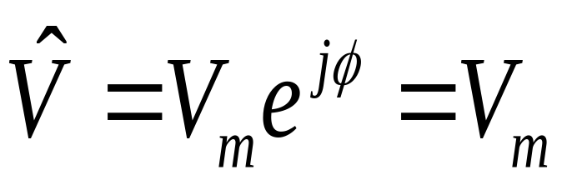
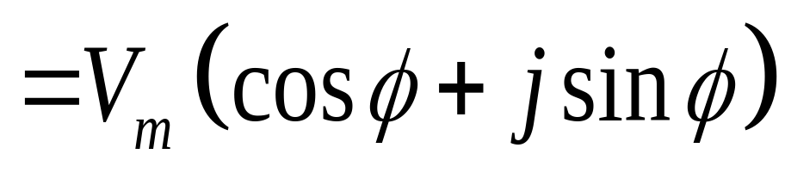

Phasor
Sinusoidal Voltage
Phasor

Slide 15
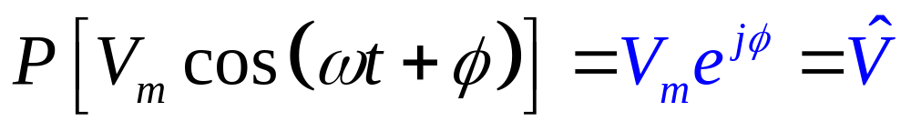
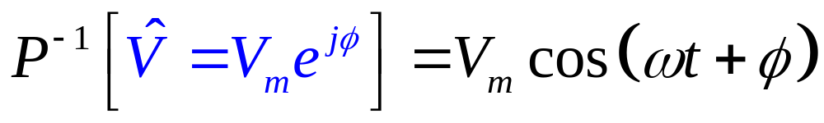
(Inverse) Phasor Transform
Phasor Transform
Inverse Phasor Transform

Slide 16
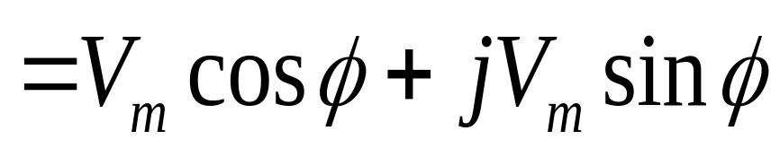
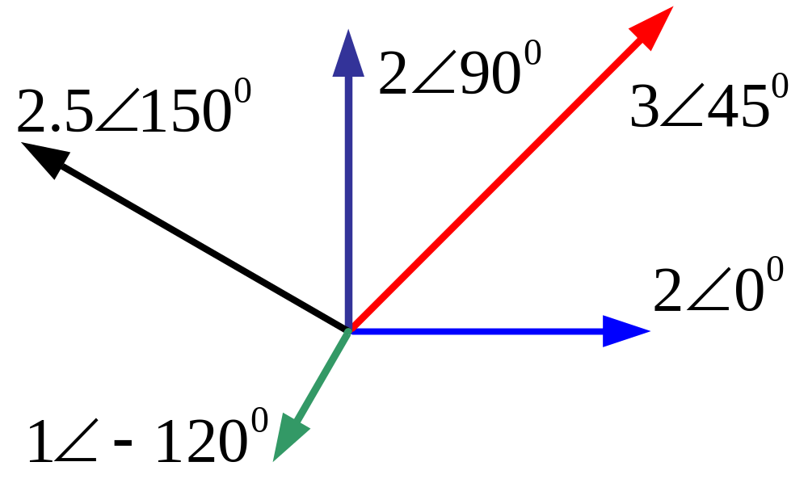
Phasor Diagram

Slide 17
Basic Operation of Phasors
Addition and Subtraction Operation
Differential Operation
Integral Operation

Slide 18
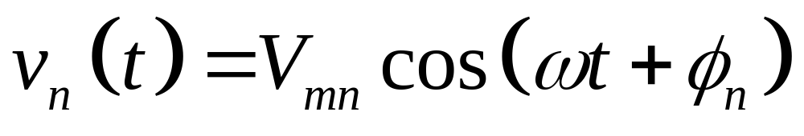
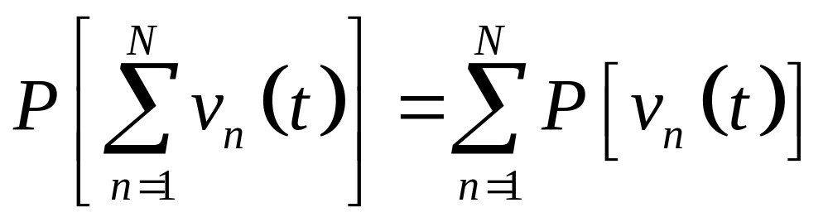
Addition and Subtraction
If
Then

Slide 19
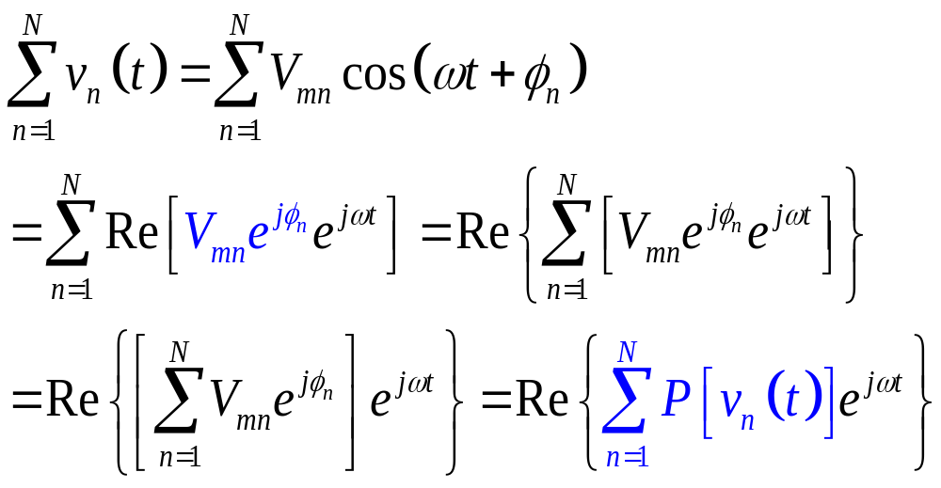
Proof:

Slide 20
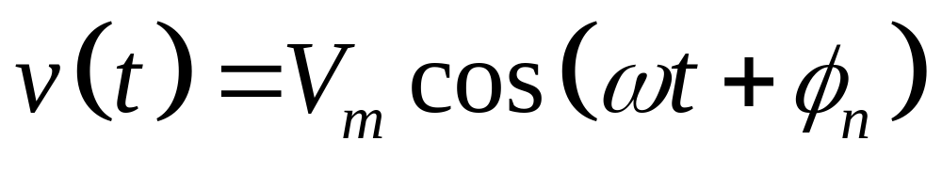
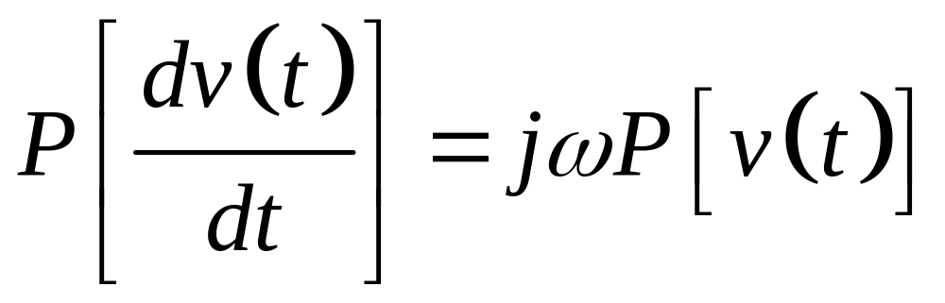
Differential Operation
If
Then

Slide 21
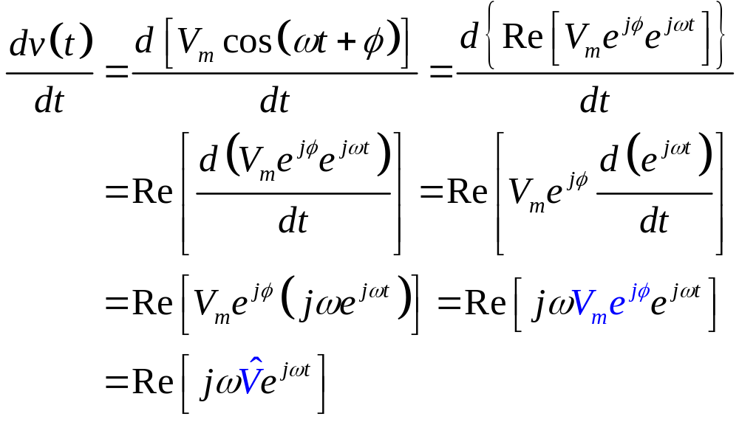
Proof:

Slide 22

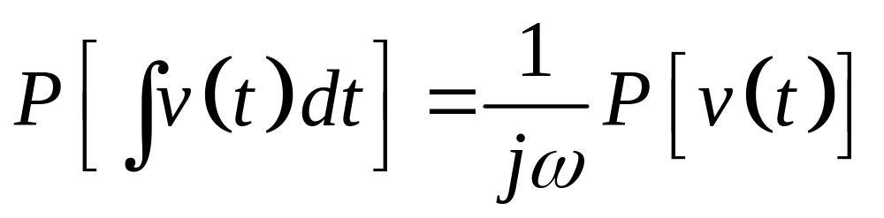
Integral Operation
If
Then

Slide 23
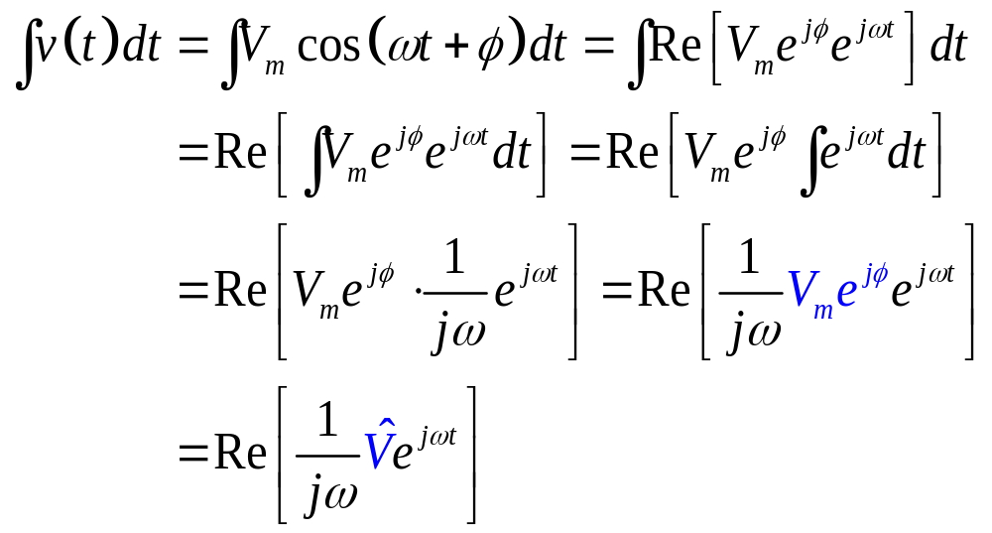
Proof:

Slide 24
7-4 VCR of Passive Elements
VCR of Resistor in Phasors
VCR of Capacitor in Phasors
VCR of Inductor in Phasors

Slide 25
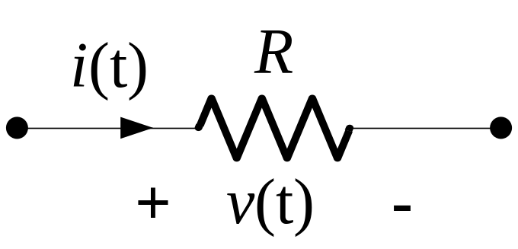
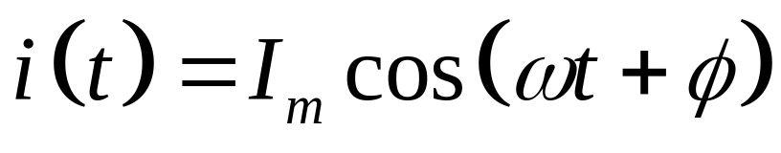
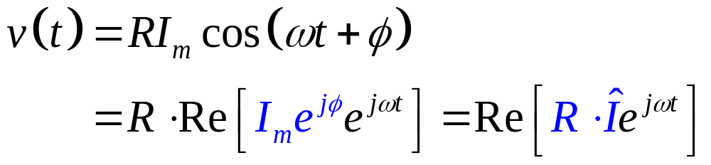
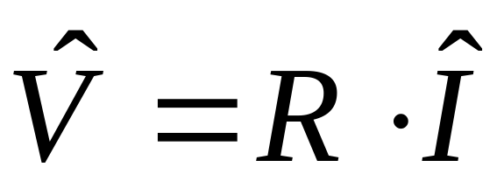
VCR of Resistor in Phasors

Slide 26
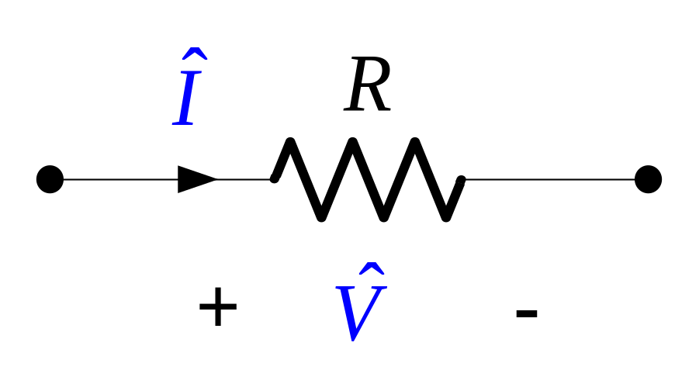
VCR of Resistor in Phasors

Slide 27
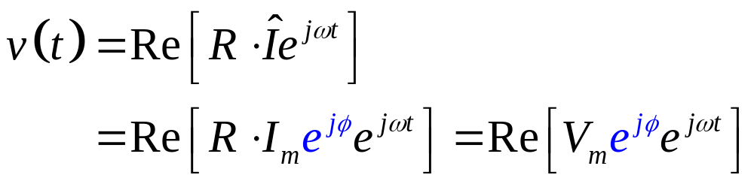
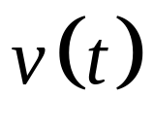
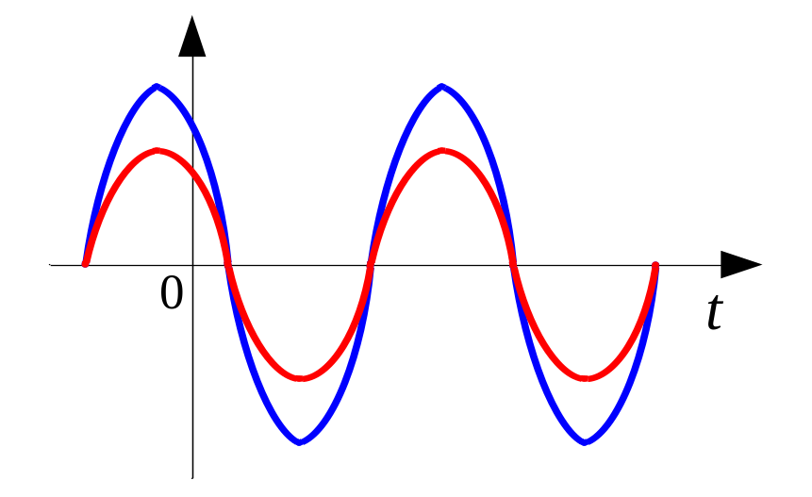
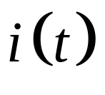
VCR of Resistors in Phasor
For resistor, v(t) and i(t) are in phase.

Slide 28
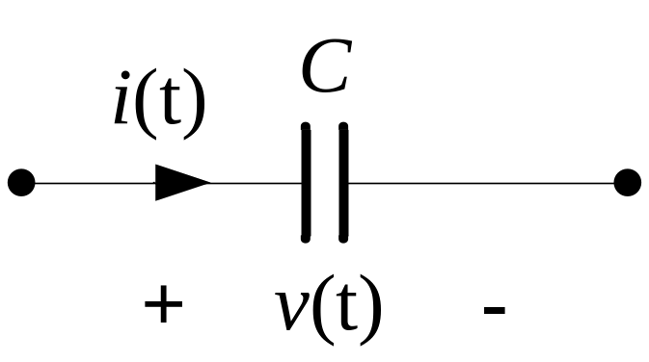

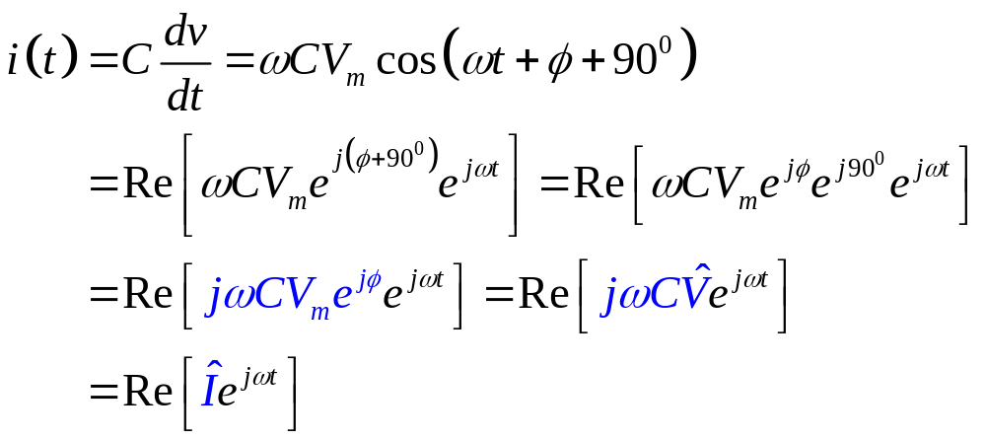
VCR of Capacitors in Phasor

Slide 29
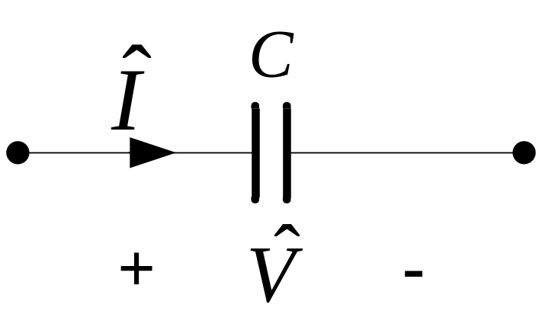

VCR of Capacitors in Phasor

Slide 30


VCR of Capacitors in Phasor
For capacitor, v(t) lags i(t) by 90⁰.

Slide 31


VCR of Inductors in Phasor

Slide 32


VCR of Inductors in Phasor

Slide 33



VCR of Inductors in Phasor
For inductor, v(t) leads i(t) by 90⁰.

Slide 34


Impedance and Admittance
Impedance:
defined as the ratio of a circuit element’s voltage phasor to its current phasor.
:measured in Ω
Admittance:
defined as the reciprocal of impedance.
:measured in S

Slide 35


Reactance and Susceptance
Reactance:
defined as the imaginary part of the impedance.
Susceptance:
defined as the imaginary of the admittance.

Slide 36
7-5 KCL and KVL in Phasors
KCL in phasor domain
KVL in phasor domain

Slide 37

KCL in Phasor Domain
The algebraic sum of all the phasor currents entering any node in a circuit is ZERO.

Slide 38


Proof:

Slide 39




KCL in Phasor Domain

Slide 40

KVL in Phasor Domain
The algebraic sum of all the phasor voltages around any loop in a circuit is ZERO.

Slide 41


Proof:

Slide 42





KVL in Phasor Domain

Slide 43



Impedances in Series and Parallel
By KVL in phasor:

Slide 44



Impedances in Series and Parallel
By KCL in phasor:

Slide 45
7-6 Mesh-Current Method in Phasor

Slide 46

Example
Find the current of i₁(t) and i₂(t) for the circuit shown above by mesh-current method.

Slide 47





Solution:

Slide 48

The phasor domain equivalent circuit is:

Slide 49


By mesh current method:

Slide 50

The required currents of i₁(t) and i₂(t) are:

Slide 51
7-7 Nodal-Voltage Method in Phasor

Slide 52




Example
A
B
Find the current of , , and for the circuit shown above by node-voltage method.

Slide 53


Solution:
Apply KCL for node A and node B:

Slide 54

Hence the required currents are:

Slide 55
7-8 Thévenin Equivalents and Norton Equivalents
Thévenin Equivalents in Frequency Domain
Norton Equivalents in Frequency Domain

Slide 56


Example
a
b
Find the current of for the circuit shown above by Thévenin equivalent.

Slide 57


Solution:
Find the open circuit voltage between terminal a and b:

Slide 58


Find the Thévenin equivalent impedance between terminal a and b:

Slide 59


Hence, the Thévenin equivalent between terminal a and b is:
a
b

Slide 60


Norton Equivalents
Norton equivalent can be derived from Thévenin equivalent by source transformation; and vice versa.

Slide 61
7-9 Sinusoidal Steady-State Power Calculations
Instantaneous Power
Average Power
Complex Power and Apparent Power
Maximum Average Power Transfer

Slide 62



Instantaneous Power
Instantaneous Power:

Slide 63


Slide 64

Average and Reactive Power

Slide 65


Average Power
P is defined as Average Power;
P is also called Real Power, or Active Power;
The unit for Average Power is Watt (W).

Slide 66

Reactive Power
Q is defined as Reactive Power;
The unit for Reactive Power is VAR (Volt-Amp Reactive).

Slide 67



Power Factor
: is defined as Power Factor Angle.

Slide 68

Complex Power and Apparent Power
: is defined as Complex Power.
The unit for Complex Power is VA (Volt-Amp).

Slide 69



Average Power:
Reactive Power:

Slide 70

Complex Power Calculation

Slide 71


Complex Power Calculation

Slide 72

Apparent Power
: is defined as Apparent Power.
The unit for Apparent Power is VA (Volt-Amp)

Slide 73




Apparent Power
Power Triangle

Slide 74




Maximum Power Transfer
Complex Power:

Slide 75


Slide 76



Let:

Slide 77



